Slide 1
Mini Popper | Colt poppers | Pepper poppers | Plates | Wall feet
3 | 6 | 3 | 0 | 66
Bay | Stage | Target Type | Count | NS | Total | Hard Cover
A3 | Newfangled | IPSC | 12 | 2 | 14 | 1 Tux 1 Left Diag
A2 | Reecycled | IPSC | 9 |  | 9 | 1 Tux
B1 | 09-13 Table Stakes | USPSA | 2 | 2 | 4
B2 | What's Up Dog | USPSA | 12 | 3 | 15 | 1 Tux 1 Right Diag
B3 | Just In Time | IPSC | 8 | 2 | 10 | 1 Left Diag 1 Right Diag
B4 | Whatchoo Got | USPSA | 9 | 2 | 11 | 1 Left Diag 1 Right Diag

Slide 2
Prop | Stage
Swinger | Stage 2 – A2
Swinger, Max Trap | Stage 6 – B4

Slide 3

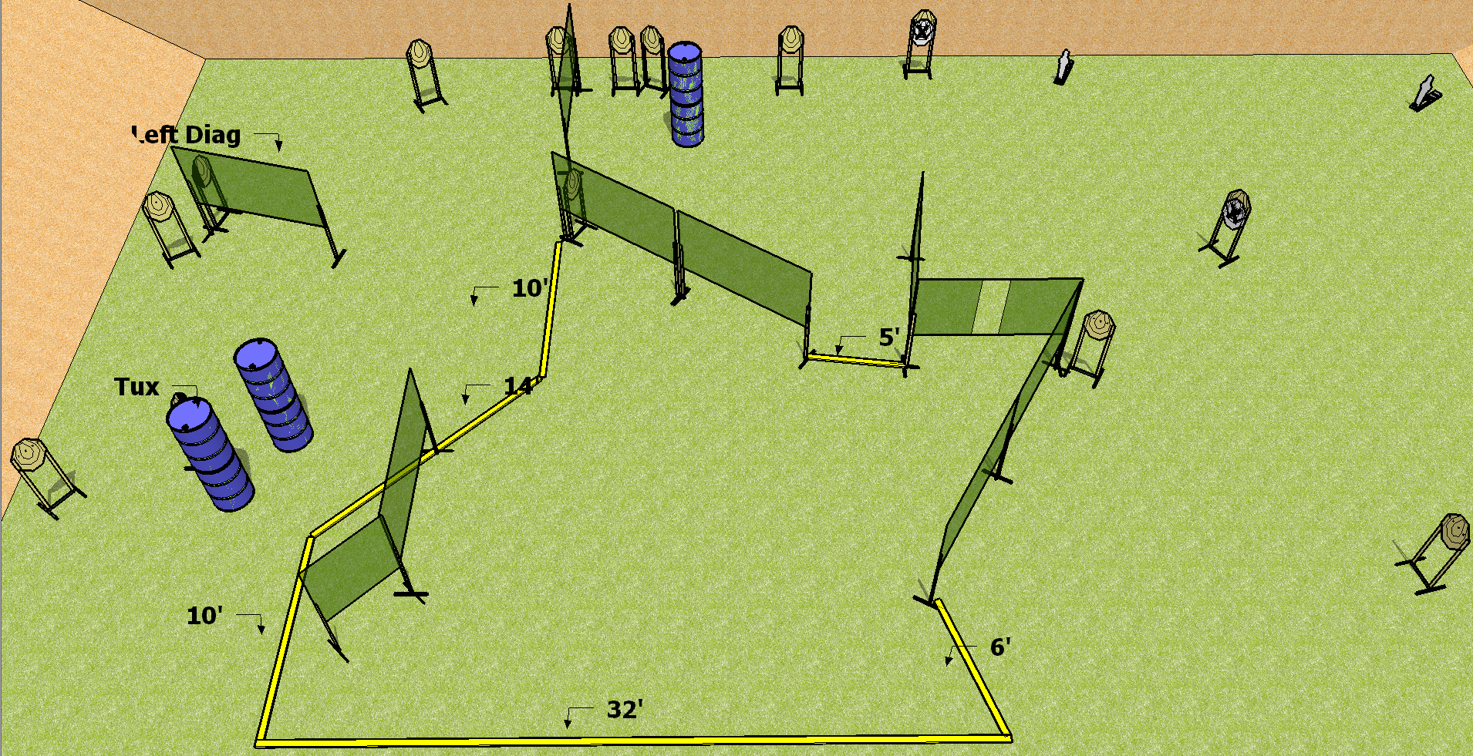
 | Dothan Practical Shooters – USPSA Match Newfangled Course Designer : Drew Coleman Bay: A3
Round Count 30 rounds 14 IPSC 2 mini poppers
Equipment List 17 wall feet 12 paper (12 + 2 NS) 1 tux, 1 left diag

Slide 4
Newfangled
Written Stage Briefing
Scoring: Comstock Rounds: 30
Targets: 14 IPSC, 2 steel
Handgun start position: anywhere inside the shooting area, wrists below belt. Handgun is loaded and holstered.
PCC start position: anywhere inside the shooting area, stock on belt. Loaded carbine is held with both hands, safety on.
Stage Procedure: on the audible start signal, engage targets as they become available from within the shooting area.

Slide 5
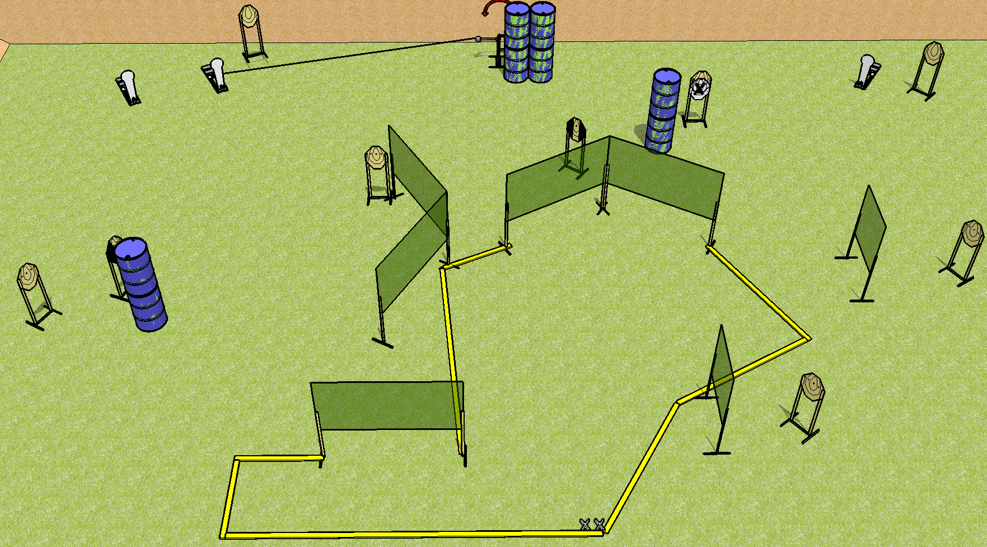
 | Dothan Practical Shooters – USPSA Match Reecycled Course Designer : Drew Coleman Bay: A2
Round Count 23 rounds 10 IPSC 3 Colt poppers
Equipment List 14 wall feet Swinger + activator 1 left diag + 1 tux 9 targets (8 + 1NS)

Slide 6
Reecycled
Written Stage Briefing
Scoring: Comstock Rounds: 23
Targets: 10 IPSC, 3 steel
Handgun start position: Heels on X’s, wrists below belt. Handgun is holstered with loaded mag, empty chamber.
PCC start position: Heels on X’s, stock on belt. Carbine has magazine inserted, empty chamber, held with both hands.
Stage Procedure: on the audible start signal, engage targets as they become available from within the shooting area. The swinger is activated by P2 and remains visible at rest.

Slide 7
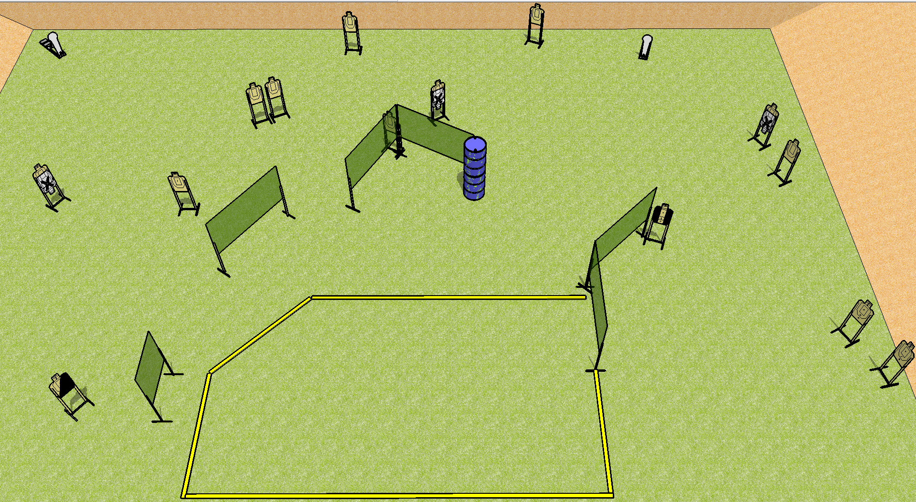
 | Dothan Practical Shooters – USPSA Match What’s Up Dog Course Designer : Drew Coleman Bay: B2
Round Count 30 rounds 14 USPSA 2 colt poppers
Equipment List 11 wall feet 1 tux, 1 right diag 15 paper (12 + 3 NS) Rear fault line 30’ across, front is 24, 10’ for the others

Slide 8
What’s Up Dog
Written Stage Briefing
Scoring: Comstock Rounds: 30 rounds
Targets: 14 USPSA, 2 steel
Handgun start position: anywhere inside the shooting area, wrists below belt. Handgun is loaded and holstered.
PCC start position: anywhere inside the shooting area, stock on belt. Loaded carbine is held with both hands, safety on.
Stage Procedure: on the audible start signal, engage targets as they become available from within the shooting are.

Slide 9
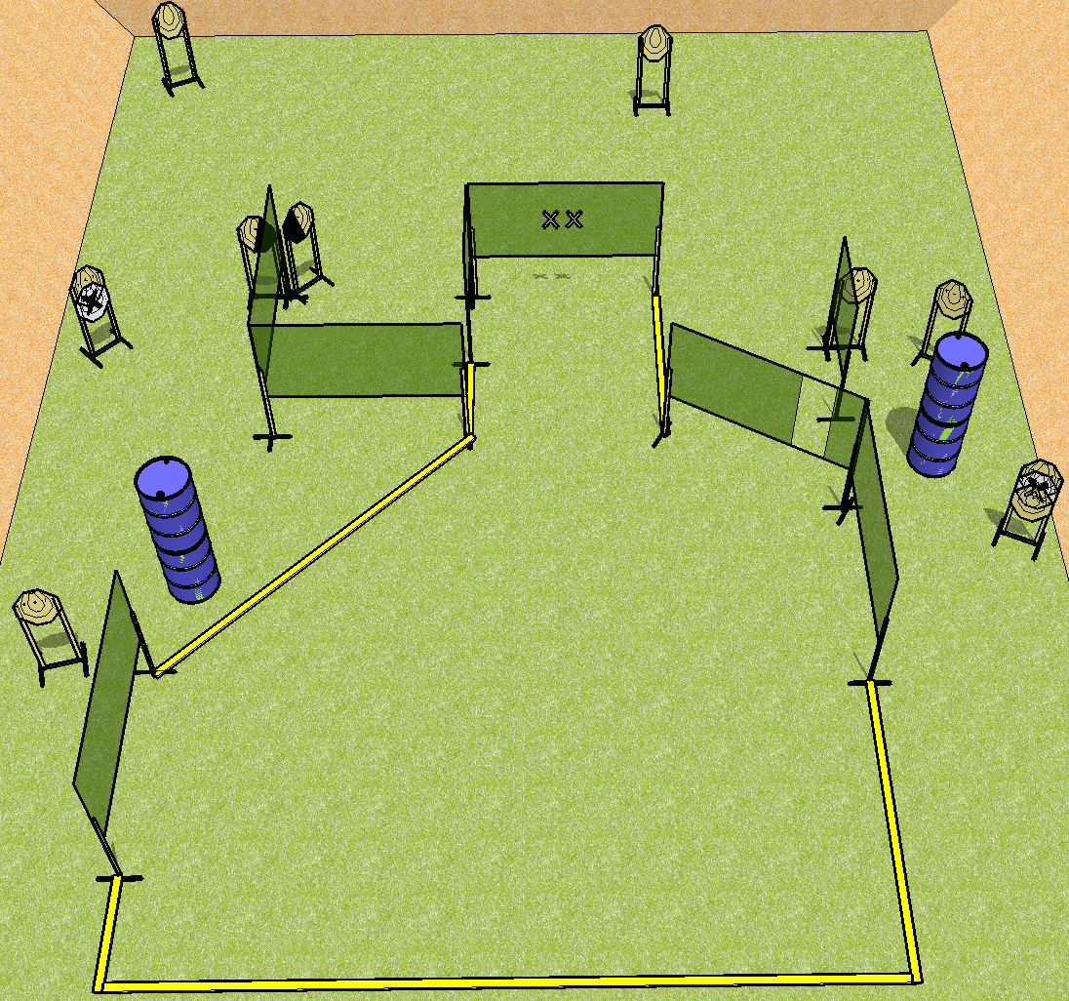
 | Dothan Practical Shooters – USPSA Match Just in Time Course Designer : Drew Coleman Bay: B3
Round Count 20 rounds 10 IPSC
Equipment List 12 wall feet 1 left + 1 right diag 10 targets (8 + 2NS)

Slide 10
Stage Name
Written Stage Briefing
Scoring: Virginia Count Rounds: 20 rounds
Targets: 10 IPSC
Handgun start position: hands touching marks. Handgun is loaded and holstered.
PCC start position: muzzle touching lower mark. Loaded carbine is held with both hands.
Stage Procedure: on the audible start signal, engage targets as they become available from within the shooting area.

Slide 11
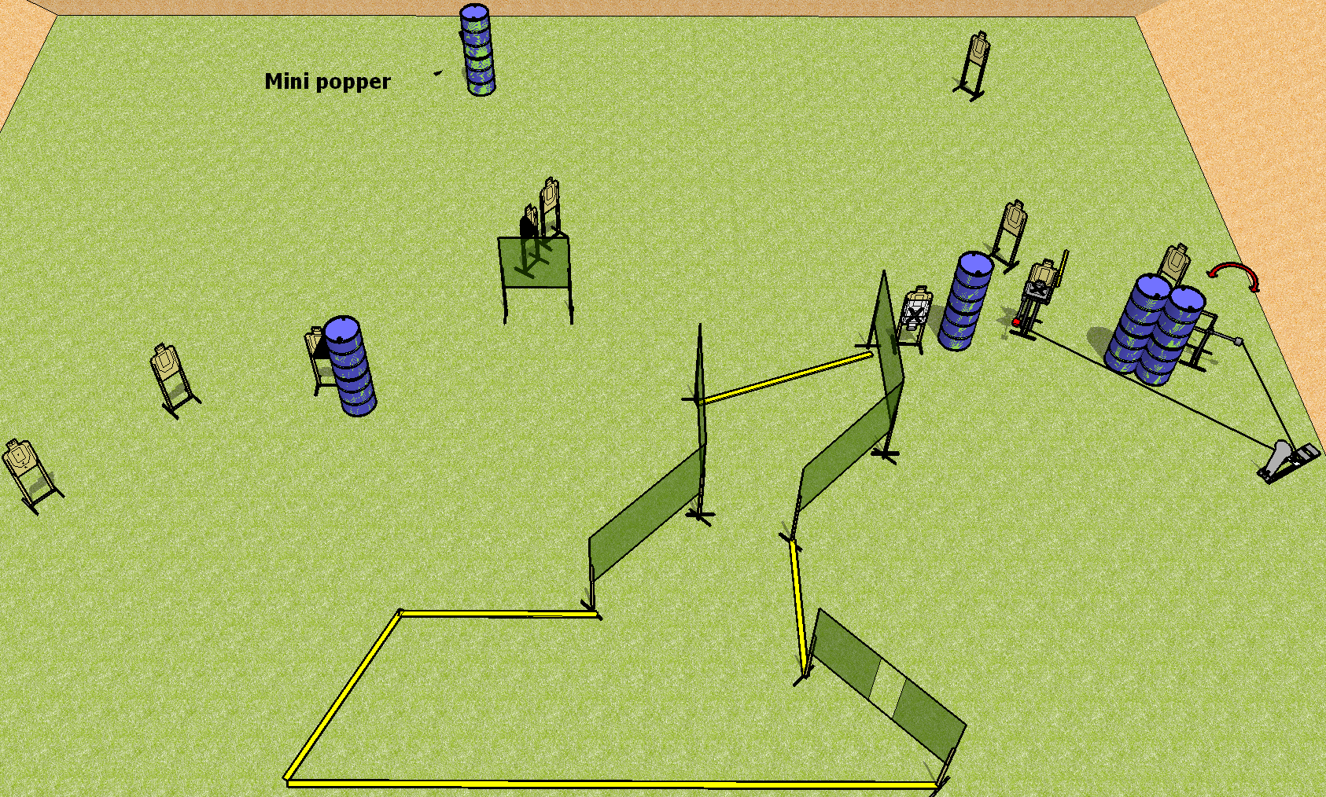
 | Dothan Practical Shooters – USPSA Match Whatchoo Got Course Designer : Drew Coleman Bay: B4
Round Count 24 rounds 11 USPSA 1 colt popper, 1 mini popper
Equipment List Swinger + Max Trap + activator 12 wall feet 1 left + 1 right diag 11 targets (9 + 2 NS)

Slide 12
Whatchoo Got
Written Stage Briefing
Scoring: Comstock Rounds: 24 rounds
Targets: 11 USPSA, 2 steel
Handgun start position: anywhere completely outside the shooting area, wrists below belt. Handgun is loaded and holstered.
PCC start position: anywhere completely outside the shooting area, stock on belt. Loaded carbine is held with both hands, safety on.
Stage Procedure: on the audible start signal, engage targets as they become available from within the shooting area. The max trap and swinger are both activated by P2 and remain visible at rest.

